Slide 1
SAP Summer School
Introduction to SAP NetWeaver™

Slide 2

Course Agenda
Introduction & Course Logistics
ERP. SAP
Evolution of Technical Infrastructure
NetWeaver™ Application Server
Survival Guide

Slide 3
Course Overview
1. Introduction & Course Logistics
Introduction to ABAP Workbench
Data Dictionary
Dynpros / SAP UI5 Fiori
ABAP Objects, OOP Concepts
ABAP 7.4+
Core Data Services (CDS)
SAP List Viewer (ALV)
Final project

Slide 4

2. ERP. SAP
Worldwide market leader in the field of ERP solutions
What is ERP?
Finance /
Accounting
Logistics
Sales and
Services
Marketing
Customer Rel.
Management
Notes:
Animation is provided ☺

Slide 5
SAP Modules
2. ERP. SAP
SAP solutions are delivered as „modules“
1 module / business unit
Each module is integrated with other modules
The customer chooses which modules he needs
 | Module Name | Description
1. | SAP FI Module | Financial Accounting
2. | SAP CO Module | Controlling
3. | SAP PS Module | Project Systems
4. | SAP HR Module | Human Resources
5. | SAP PM Module | Plant Maintenance
6. | SAP QM Module | Quality Management
7. | SAP PP Module | Production Planning
8. | SAP SD Module | Sales and Distribution
9. | SAP BW Module | Business Warehouse
10. | SAP EC Module | Enterprise Controlling
11. | SAP TR Module | Treasury
… | … | …
Notes:
SAP tries very hard to be all things to all companies, and although it fails to supply everything under the sun, there is a continual flow of new applications, upgrades and industry-specific add-ons.

Slide 6
Standard Software vs. Custom Software
2. ERP. SAP
Standard
Processes are valid for a whole business unit
Solutions are already used in production
Smaller costs
Less time for implementation
Standard Software
ERP Systems
Custom
Processes are adapted to match the requirements of a customer
Risks are assumed by the customer
Higher costs
Longer implementation time
Custom
Notes:
The term standard solution, however, doesn‘t mean that its features are rigid and inflexible. Rather, there are often multiple integrated kinds of processes within the SAP system.
Customizing: adapt the SAP system to a special customer requirement, even extend them with specific customer data

Slide 7
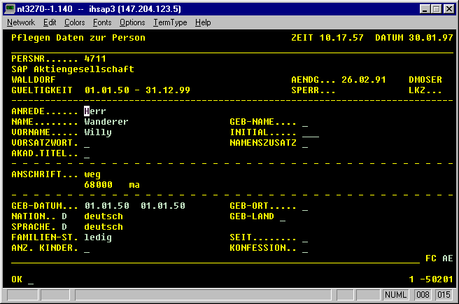
SAP R/2: 1979 - 1992
3. Evolution of Technical Infrastructure
Real-time ERP solution running on enterprise mainframes
Integrated many of an enterprise’s functions: accounting, manufacturing, supply chain management etc.
2-tier architecture with terminal based user interface

Slide 8
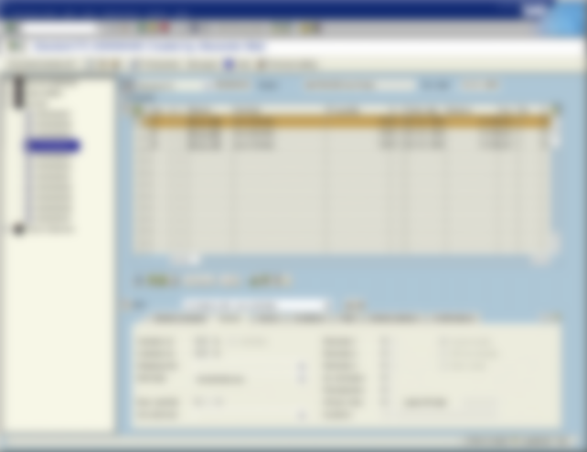
SAP R/3: 1992 - 2001
3. Evolution of Technical Infrastructure
R/3 brings ERP solutions to the desktop computer
3-tier Architecture
The advent of Dynpro technology
Any Dynpro(Dynamic Program) consists of
Screen layout
Corresponding flow logic
RDBMS
SAP Application Server
Local Computer
Flow logic
Flow logic
Screen Layout

Slide 9
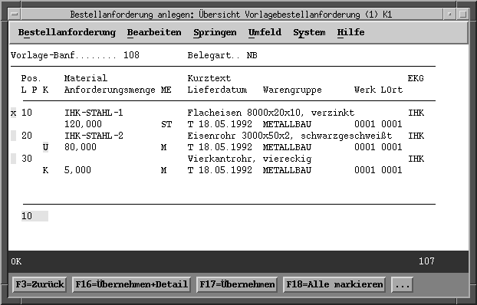
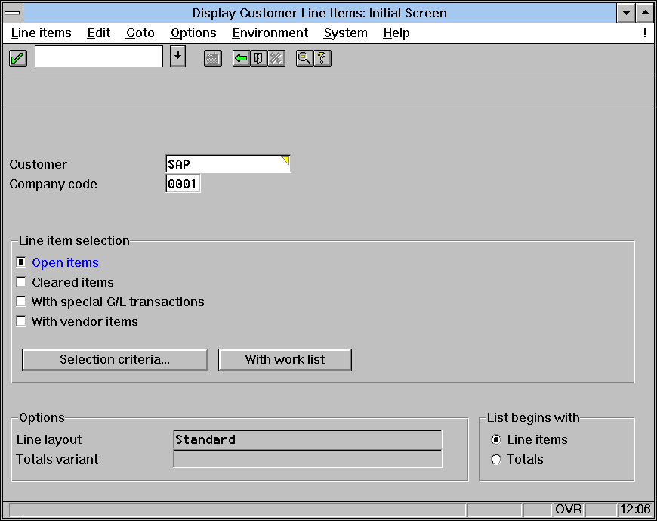
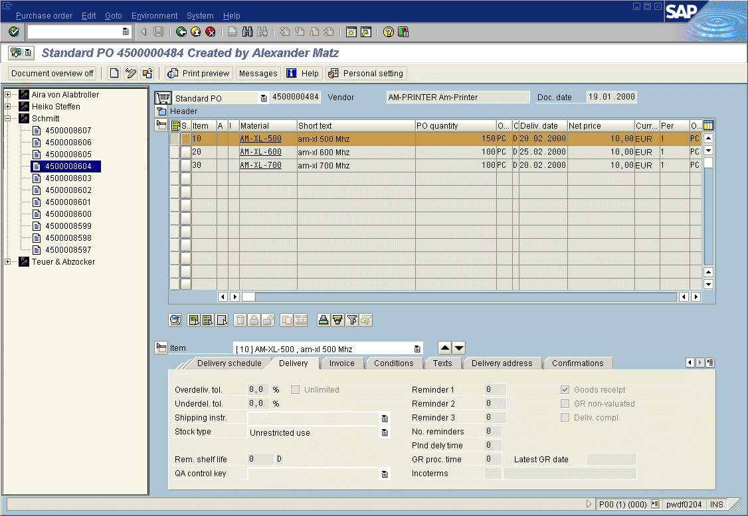
SAP R/3: 1992 - 2001
3. Evolution of Technical Infrastructure
R/3 1.0 - 1992
First “graphical” user interface
R/3 2.0 - 1993
A bit of windows “look&feel”
R/3 4.6 - 2001
Screen reinvented to allow
multiple areas, branding
and others
Notes:
Why SAP R/3 has been successful? Key-points: Integrated, secured information, support for multiple languages, currencies…

Slide 10
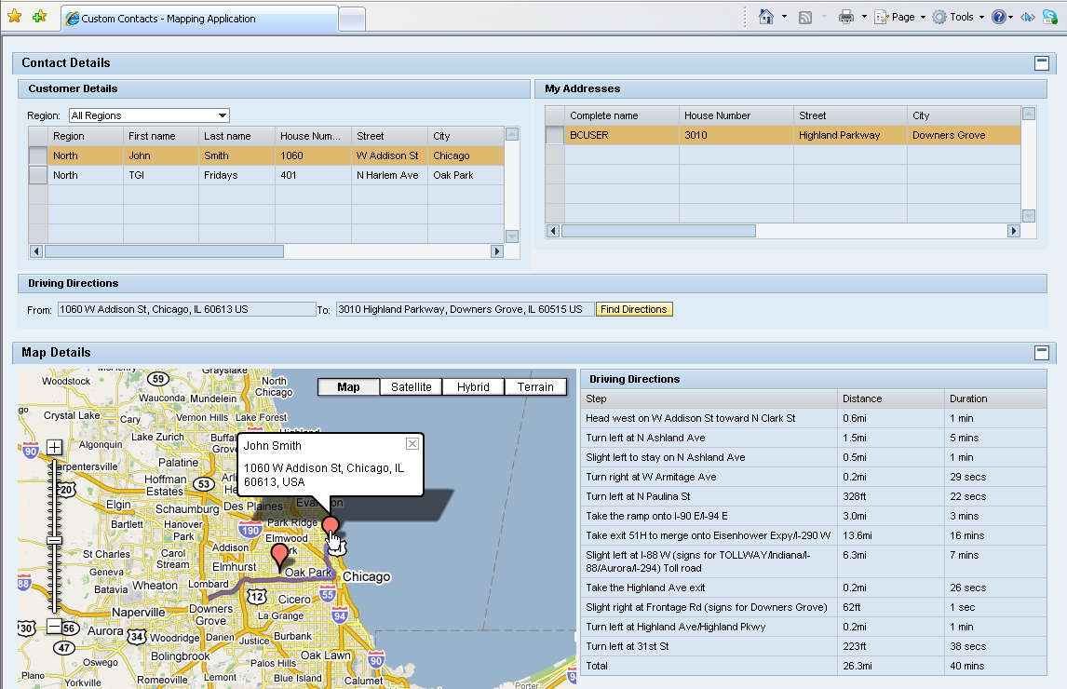
Web Dynpro: 2003 - ?
3. Evolution of Technical Infrastructure
SAP standard UI technology for developing Web applications in the ABAP environment
Web Dynpro applications can be developed using either a Java or ABAP flavor
„Minimize coding, maximize design“

Slide 11
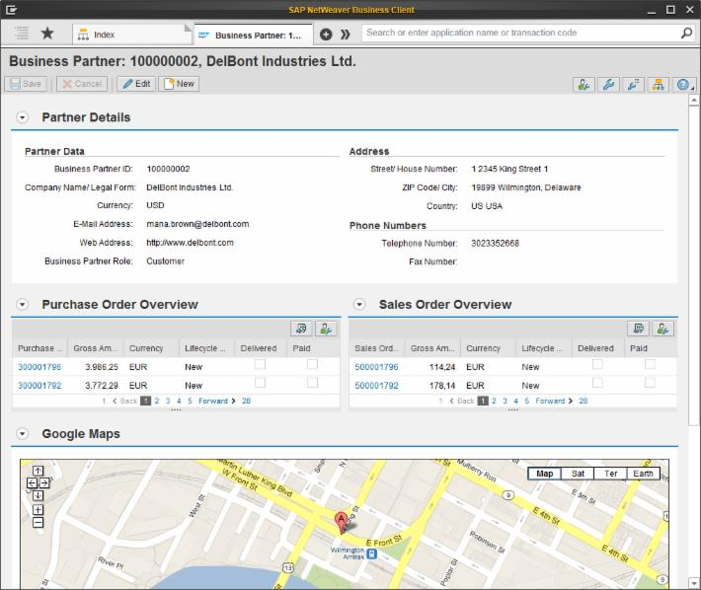
Floorplan Manager in Web Dynpro
3. Evolution of Technical Infrastructure
Floorplan Manager (FPM) is a framework for developing Web Dynpro application interfaces consistent with SAP UI guidelines
FPM provides pre-defined UI building blocks (UIBBs) to support and accelerate the creation of application-specific views

Slide 12
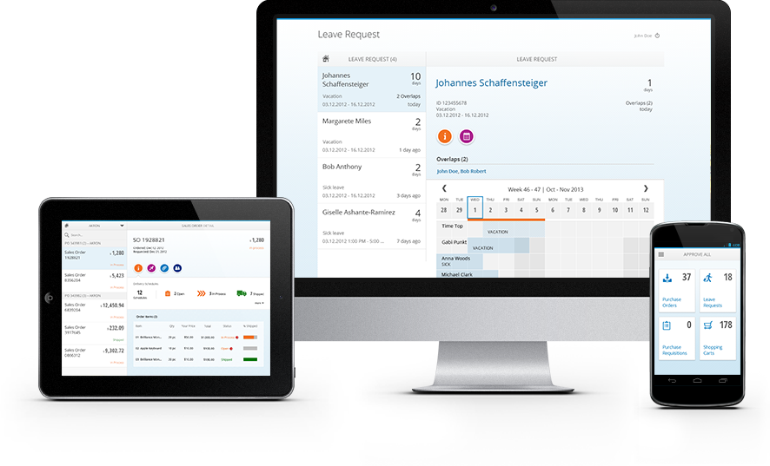
SAP Fiori
3. Evolution of Technical Infrastructure
Notes:
SAP Fiori refers to a set of applications that were built using SAPUI5 and can be customized using SAPUI5.
A SAP Fiori screen is designed to be viewed on a smartphone, and performs one task only, showing a minimum of UI elements (buttons etc.).
Advantages: responsive design, easy navigation and reading, same experience on all devices (tablet, phone, desktop)

Slide 13
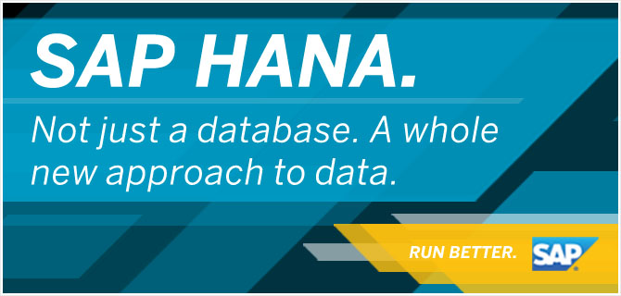
SAP HANA
3. Evolution of Technical Infrastructure
Platform for real-time data management
SAP HANA is a high-end database for business transactions and reporting, which uses a combination of in-memory computing and column-oriented storage for the sake of optimization
Existing projects can also fully benefit from the advantages of SAP HANA
More functions for data management are included
Replication, extraction, transformation, load and so on
Data analysis functions: data mining, text search and predictive analysis
Notes:
Due to the growing number of standard implementations for processes and the large amount of data exchanged between systems,
SAP moved on to designing a solution that would work in real-time

Slide 14
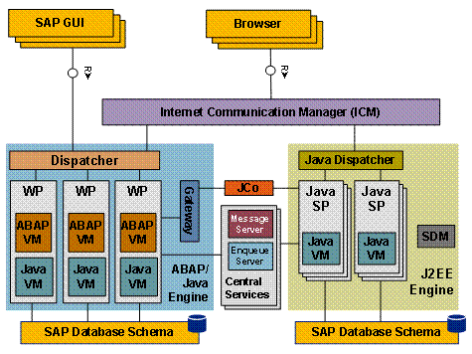
4. NetWeaver™ Application Server
SAP NetWeaver AS is a development and deployment platform that supports web services, business applications and standards-based development based on key technologies such as J2EE and ABAP.
Notes:
Should mention here about: architecture, processes, system landscape (centralized vs. local, mandt…), namespace (ensure that there will be no name conflicts between SAP and customer objects)

Slide 15
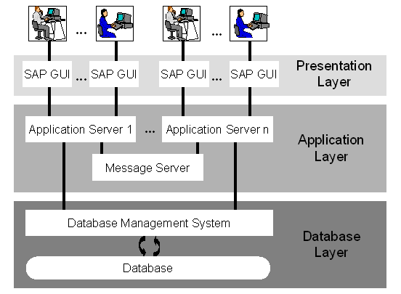
Internal Architecture
4. NetWeaver™ Application Server
Three-tier architecture (Presentation – Application – Database layer)
https://help.sap.com/saphelp_46c/helpdata/en/fc/eb2e97358411d1829f0000e829fbfe/content.htm
Notes:
R/3

Slide 16
Clients and Their Roles
4. NetWeaver™ Application Server
Client allows an organization using an SAP system to split the system into logical subunits.
A client is an entity with independent information and data.
Log on a particular client of the system
A different client can be used for another type of activity (customizing, quality assurance …)
Often used as primary key in database tables
Notes:
One SAP system can be used for several independent companies (or subsidiaries of a company). The client is used to separate the data of these companies. Most database tables in an SAP system therefore have the client is a key. This is used e.g. for transactional data, master data and client dependent customizing data. Nevertheless there is also customizing that is valid across all clients (so called cross client customizing.)
In a nutshell: Client is a key field in most database tables to separate data of multiple companies using the same SAP system. Each company has its own client number.

Slide 17
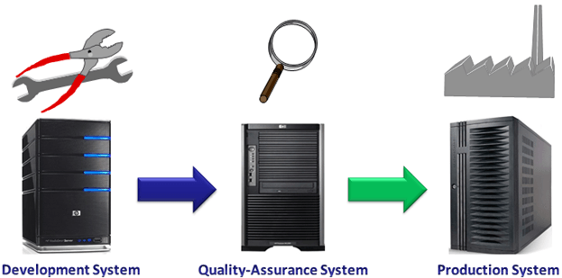
System Landscape
4. NetWeaver™ Application Server
Example of a geographically distributed development
The three-system landscape is recommended by SAP
Changes will flow from DEV->QAS->PRD and not backwards (via „Transport Requests“)
Notes:
Small „SAP“ truck on arrows for representing transports?
DEVELOPMENT : is where the consultants do the customization as per the company's requirement. QUALITY : is where the core team members and other members test the customization. PRODUCTION : is where the live data of the company is recorded.

Slide 18
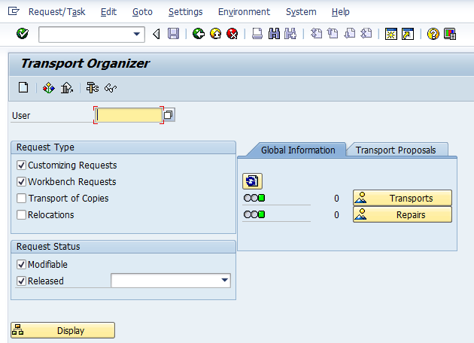
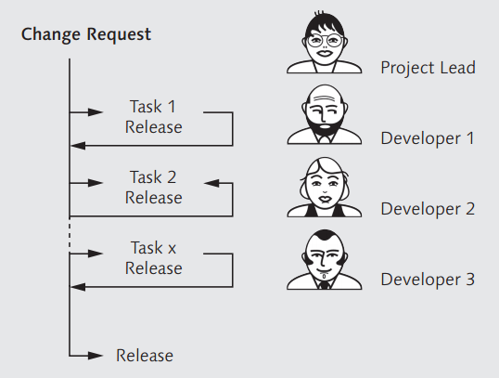
The Concept of Transport
4. NetWeaver™ Application Server
Customizing and changed or newly created objects are transferred to other systems in the landscape through transports.
Various changes are grouped into multiple tasks, each of which is assigned to one user.
Notes:
All transports (both exports and imports) take place in several steps, each of them being logged.

Slide 19
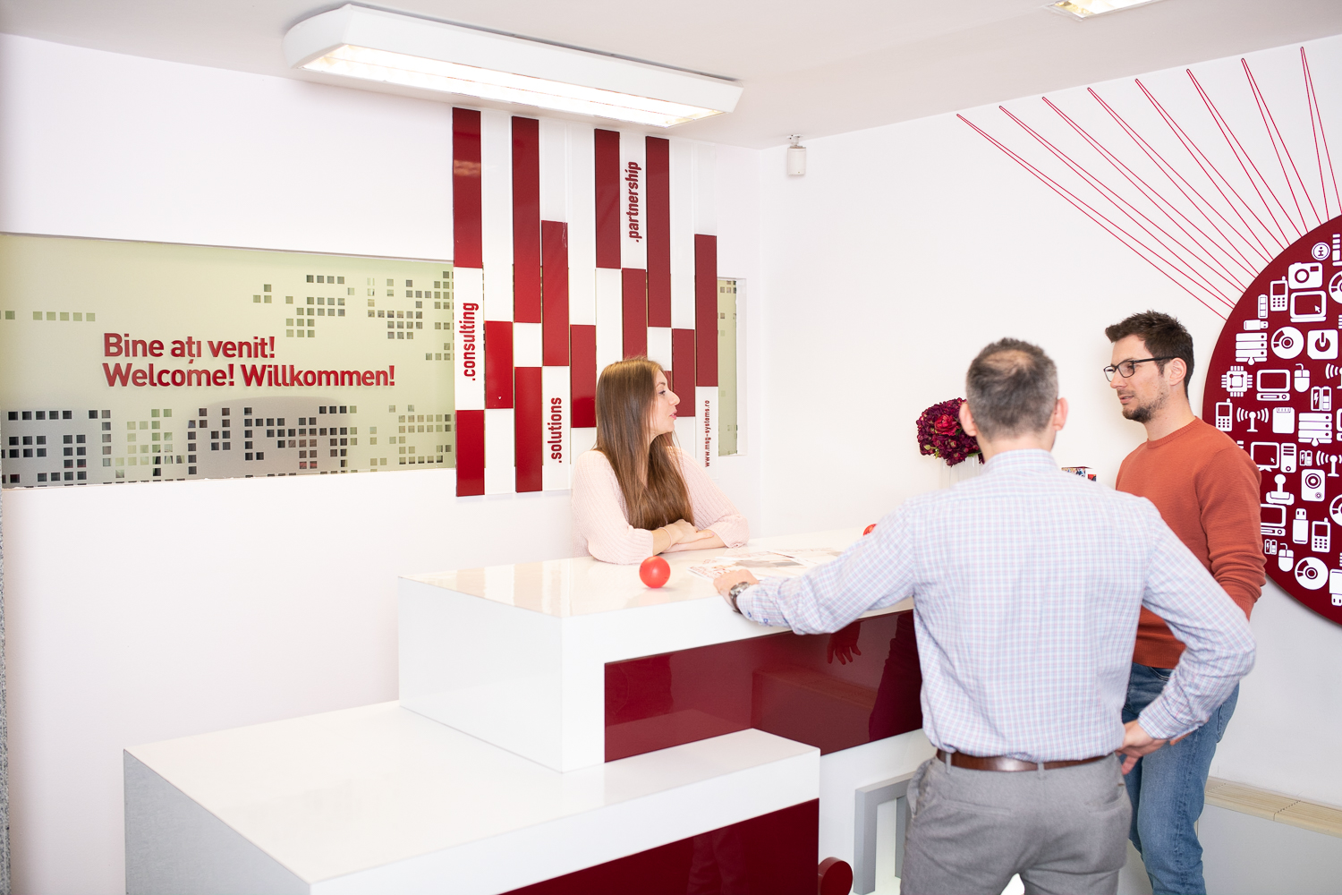
Object Repository
4. NetWeaver™ Application Server
ABAP Dictionary
Database tables
Data elements and domains
ABAP Reports
Selection Screens
Function Modules
ABAP Web Dynpro

Slide 20
Development Environment
4. NetWeaver™ Application Server
SAP GUI
Eclipse

Slide 21

5. Survival Guide
?
?
NetWeaver
Fiori
SAP
?
?
ERP
?
?
UI5
ABAP
Workbench
Web Dynpro
Transport

Slide 22
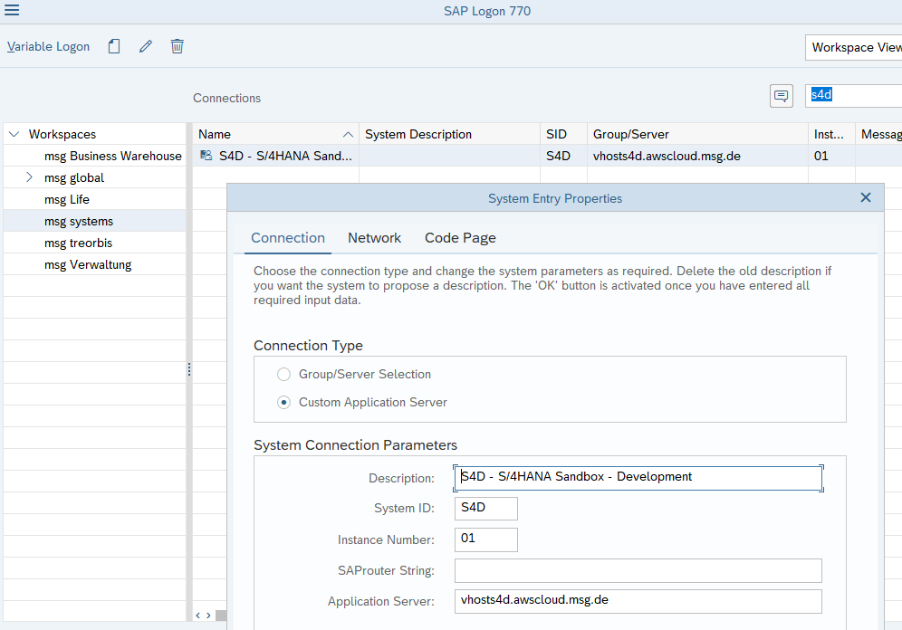
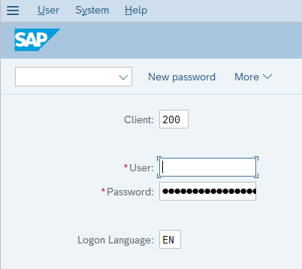
Getting started with the SAP system
5. Survival Guide
Logging on to an SAP system
Select system
Enter your credentials

Slide 23
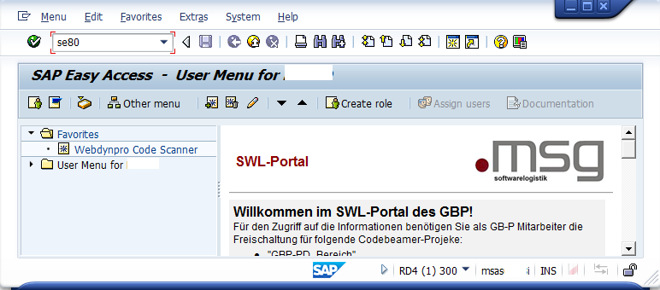
SAP Easy Access and navigation options
5. Survival Guide
Opens after you log on
Command field
New session
Application bar
Status bar

Slide 24
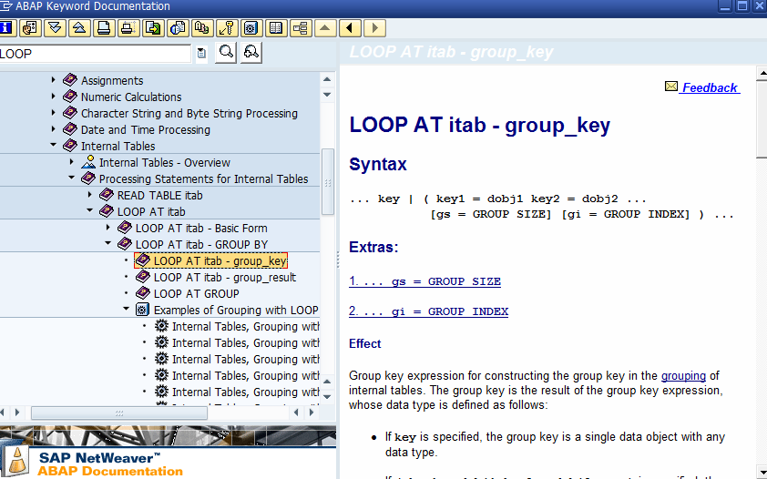
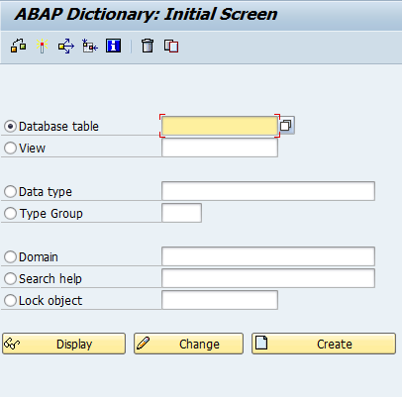
SAP Library and Help options
5. Survival Guide
F1
F4

Slide 25
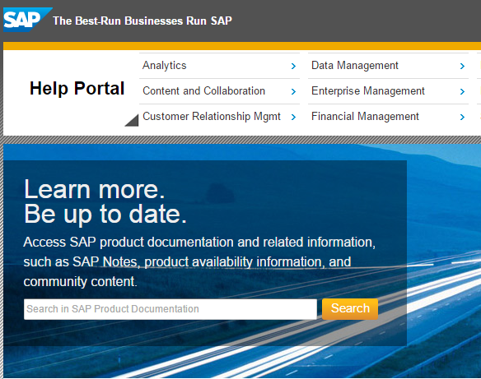

Education Services
5. Survival Guide
SAP Help Portal
Open SAP
http://help.sap.com/
https://open.sap.com/

Slide 26


